Slide 1
Distributed Systems in Real-World Applications
Understanding How Distributed Systems Power Modern Technology

Slide 2
What is a Distributed System?
A distributed system is a collection of independent computers that work together as a single system. The goal is to share resources, provide scalability, and ensure reliability.

Slide 3
Common Examples and Real-World Applications
1. Web and Cloud Services
Examples: Google Search, Amazon Web Services (AWS), Microsoft Azure, Netflix, YouTube.
Purpose: Handle millions of requests per second by distributing workload across thousands of servers globally.
Benefit: High availability and fault tolerance — if one server fails, others take over seamlessly.

Slide 4
Common Examples and Real-World Applications Cont..
2. Data Storage and Databases
Examples: Cassandra, MongoDB, Google Bigtable, Amazon DynamoDB, HDFS (Hadoop Distributed File System).
Purpose: Store and process massive datasets across multiple machines.
Benefit: Scalability (add more nodes to increase capacity) and resilience against hardware failures.

Slide 5
Common Examples and Real-World Applications Cont..
3.E-commerce and Online Platforms
Examples: Amazon, eBay, Shopify.
Purpose: Handle user authentication, payments, inventory, and recommendation systems across many servers.
Benefit: Fast response times worldwide and no single point of failure.

Slide 6
Common Examples and Real-World Applications Cont..
4. Social Media and Messaging SystemsExamples: Facebook, Twitter (X), WhatsApp, Slack, Discord.
Purpose: Support billions of users sharing content and messages in real-time.
Benefit: Load balancing, data replication, and real-time consistency.

Slide 7
Common Examples and Real-World Applications Cont..
5. Machine Learning and Big Data Analytics
Examples: Apache Spark, TensorFlow Distributed, Hadoop MapReduce.
Purpose: Train ML models or process huge datasets across many nodes in parallel.
Benefit: Faster computation and the ability to handle petabytes of data.

Slide 8
Common Examples and Real-World Applications Cont..
6. Blockchain and Cryptocurrency Networks
Examples: Bitcoin, Ethereum, Hyperledger.
Purpose: Maintain decentralized, tamper-proof ledgers across thousands of nodes.
Benefit: Trustless operation — no central authority required.

Slide 9
Common Examples and Real-World Applications Cont..
7. Financial Systems
Examples: Stock exchanges, payment gateways, online banking systems.
Purpose: Support high-frequency trading, real-time transactions, and distributed ledger systems.
Benefit: Fault-tolerance and low-latency processing.

Slide 10
Common Examples and Real-World Applications Cont..
8. IoT (Internet of Things) and Edge Computing
Examples: Smart homes devices, autonomous vehicles, industrial IoT networks.
Purpose: Coordinate and process data from millions of devices in real-time.
Benefit: Reduced latency and local decision-making.

Slide 11
Common Examples and Real-World Applications Cont..
9. Online Gaming and Virtual Worlds
Examples: Fortnite, Minecraft, Roblox.
Purpose: Maintain consistent game states across multiple servers and players worldwide.
Benefit: Scalability and synchronized multiplayer experiences.

Slide 12
Common Examples and Real-World Applications Cont..
10. Content Delivery Networks (CDNs)
Examples: Cloudflare, Akamai, Fastly.
Purpose: Deliver web content and media closer to users geographically.
Benefit: Faster load times and reduced latency.

Slide 13
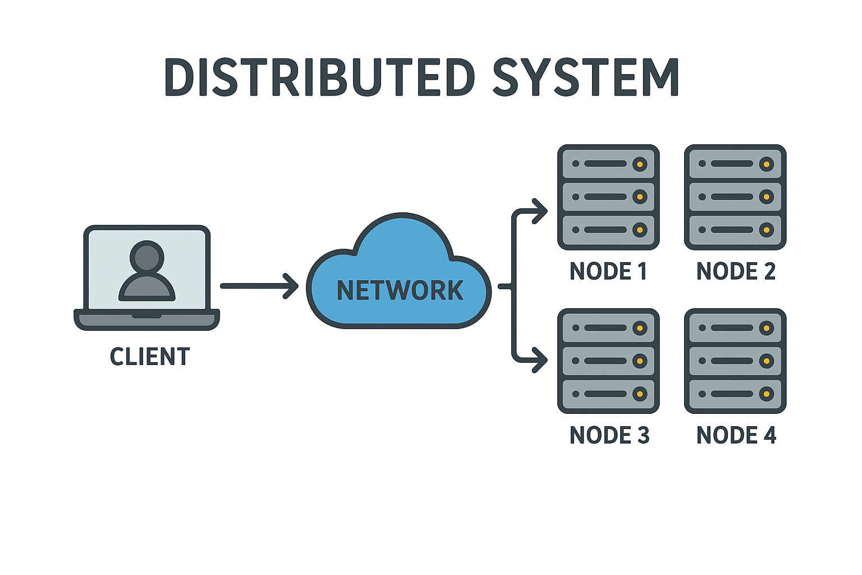
How a Distributed System Works

Slide 14
Summary
Distributed systems are used wherever scalability, availability, fault-tolerance, and performance are critical. They are the backbone of modern internet-scale applications or Distributed systems are essential for handling large-scale applications that require high availability, scalability, and performance. They are the backbone of cloud computing, online services, and global data processing.

Slide 15
Review Questions
1. What is a distributed system, and what are its main goals?
2. Mention three examples of real-world applications that use distributed systems.
3. How do distributed systems improve reliability and scalability?
4. Why distributed systems are important for cloud computing and web services?
5. Explain how distributed systems are used in data storage and databases.
6. What is the role of distributed systems in IoT and edge computing?
7. How do blockchain networks rely on distributed systems?
8. Give examples of industries that benefit most from distributed systems.
9. What are the main challenges in designing distributed systems?

